Slide 1

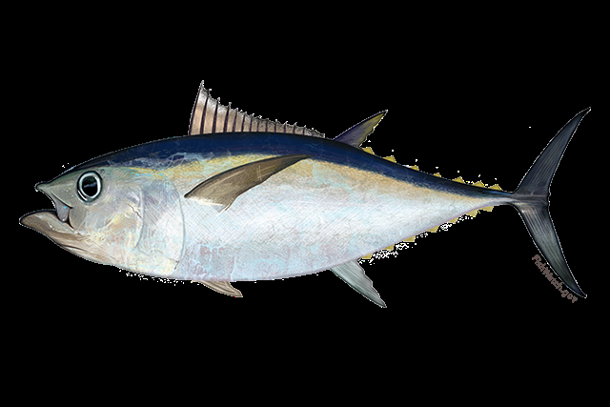
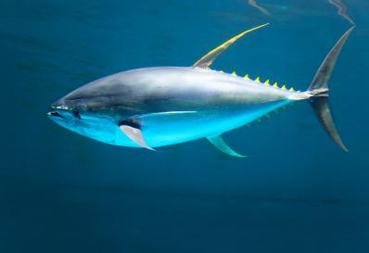
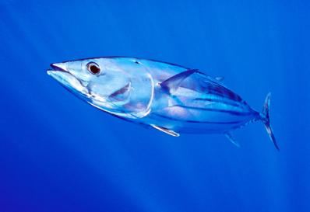
SCRS Report 2019
Panel 1- Tropical Tunas
Bigeye
Yellowfin
Skipjack

Slide 2

Tropical Tuna Summary
Presentation Summary
  AOTTP
  State of Stocks and Outlook (from Executive Summaries)
  BET, YFT and SKJ
  Effects of Current regulations (from Executive Summaries)
  Management recommendations(from Executive Summaries)
  Responses to the Commission

Slide 3
The Atlantic Ocean Tropical tuna Tagging Programme (AOTTP)
Research Programs - AOTTP
The 5-year project officially began in June 2015 and will end 30 Nov 2020.
The overall objective of the AOTTP Programme is to contribute to food security and economic growth of the Atlantic coastal states by ensuring sustainable management of tropical tuna resources in the Atlantic Ocean.
Program activities
include:
  Tagging of tropical tuna in the Atlantic
  Training and capacity building in ‘developing’ CPCs
  Coordinating shore-based tag recovery and awareness teams
  Developing publicity campaigns and incentive schemes (e.g. rewards)
  Collecting and verifying all data and populating ICCAT databases
  Analysing, summarising and making data available to the SCRS
  Facilitating and promoting collaborative research and stock assessments

Slide 4

AOTTP - Budget
Research Programs - AOTTP
EU contributing with 90% of the overall 15 M€ for a 5 year period (ends June 2020)
10% from ICCAT Contracting Parties and Contributors (USA, China, Canada, Uruguay, Chinese-Taipei)
 | Year 1 | Year 2 | Year 3 | Year 4
Human resources | 179,405 € | 317,300 € | 413,784 € | 415,335 €
Other costs | 135,699 € | 356,065 € | 315,951 € | 414,536 €
Travel | 8,984 € | 37,043 € | 67,448 € | 49,134 €
Equipment/supplies | 846,148 € | 121,176 € | 141,710 € | 59 254 €
Tagging | 920,254 € | 3,508,274 € | 2,270,085 € | 1,983,503€
TOTAL | 2,090,490 € | 4,339,858 € | 3,208,978 € | 2,921,762 €

Slide 5
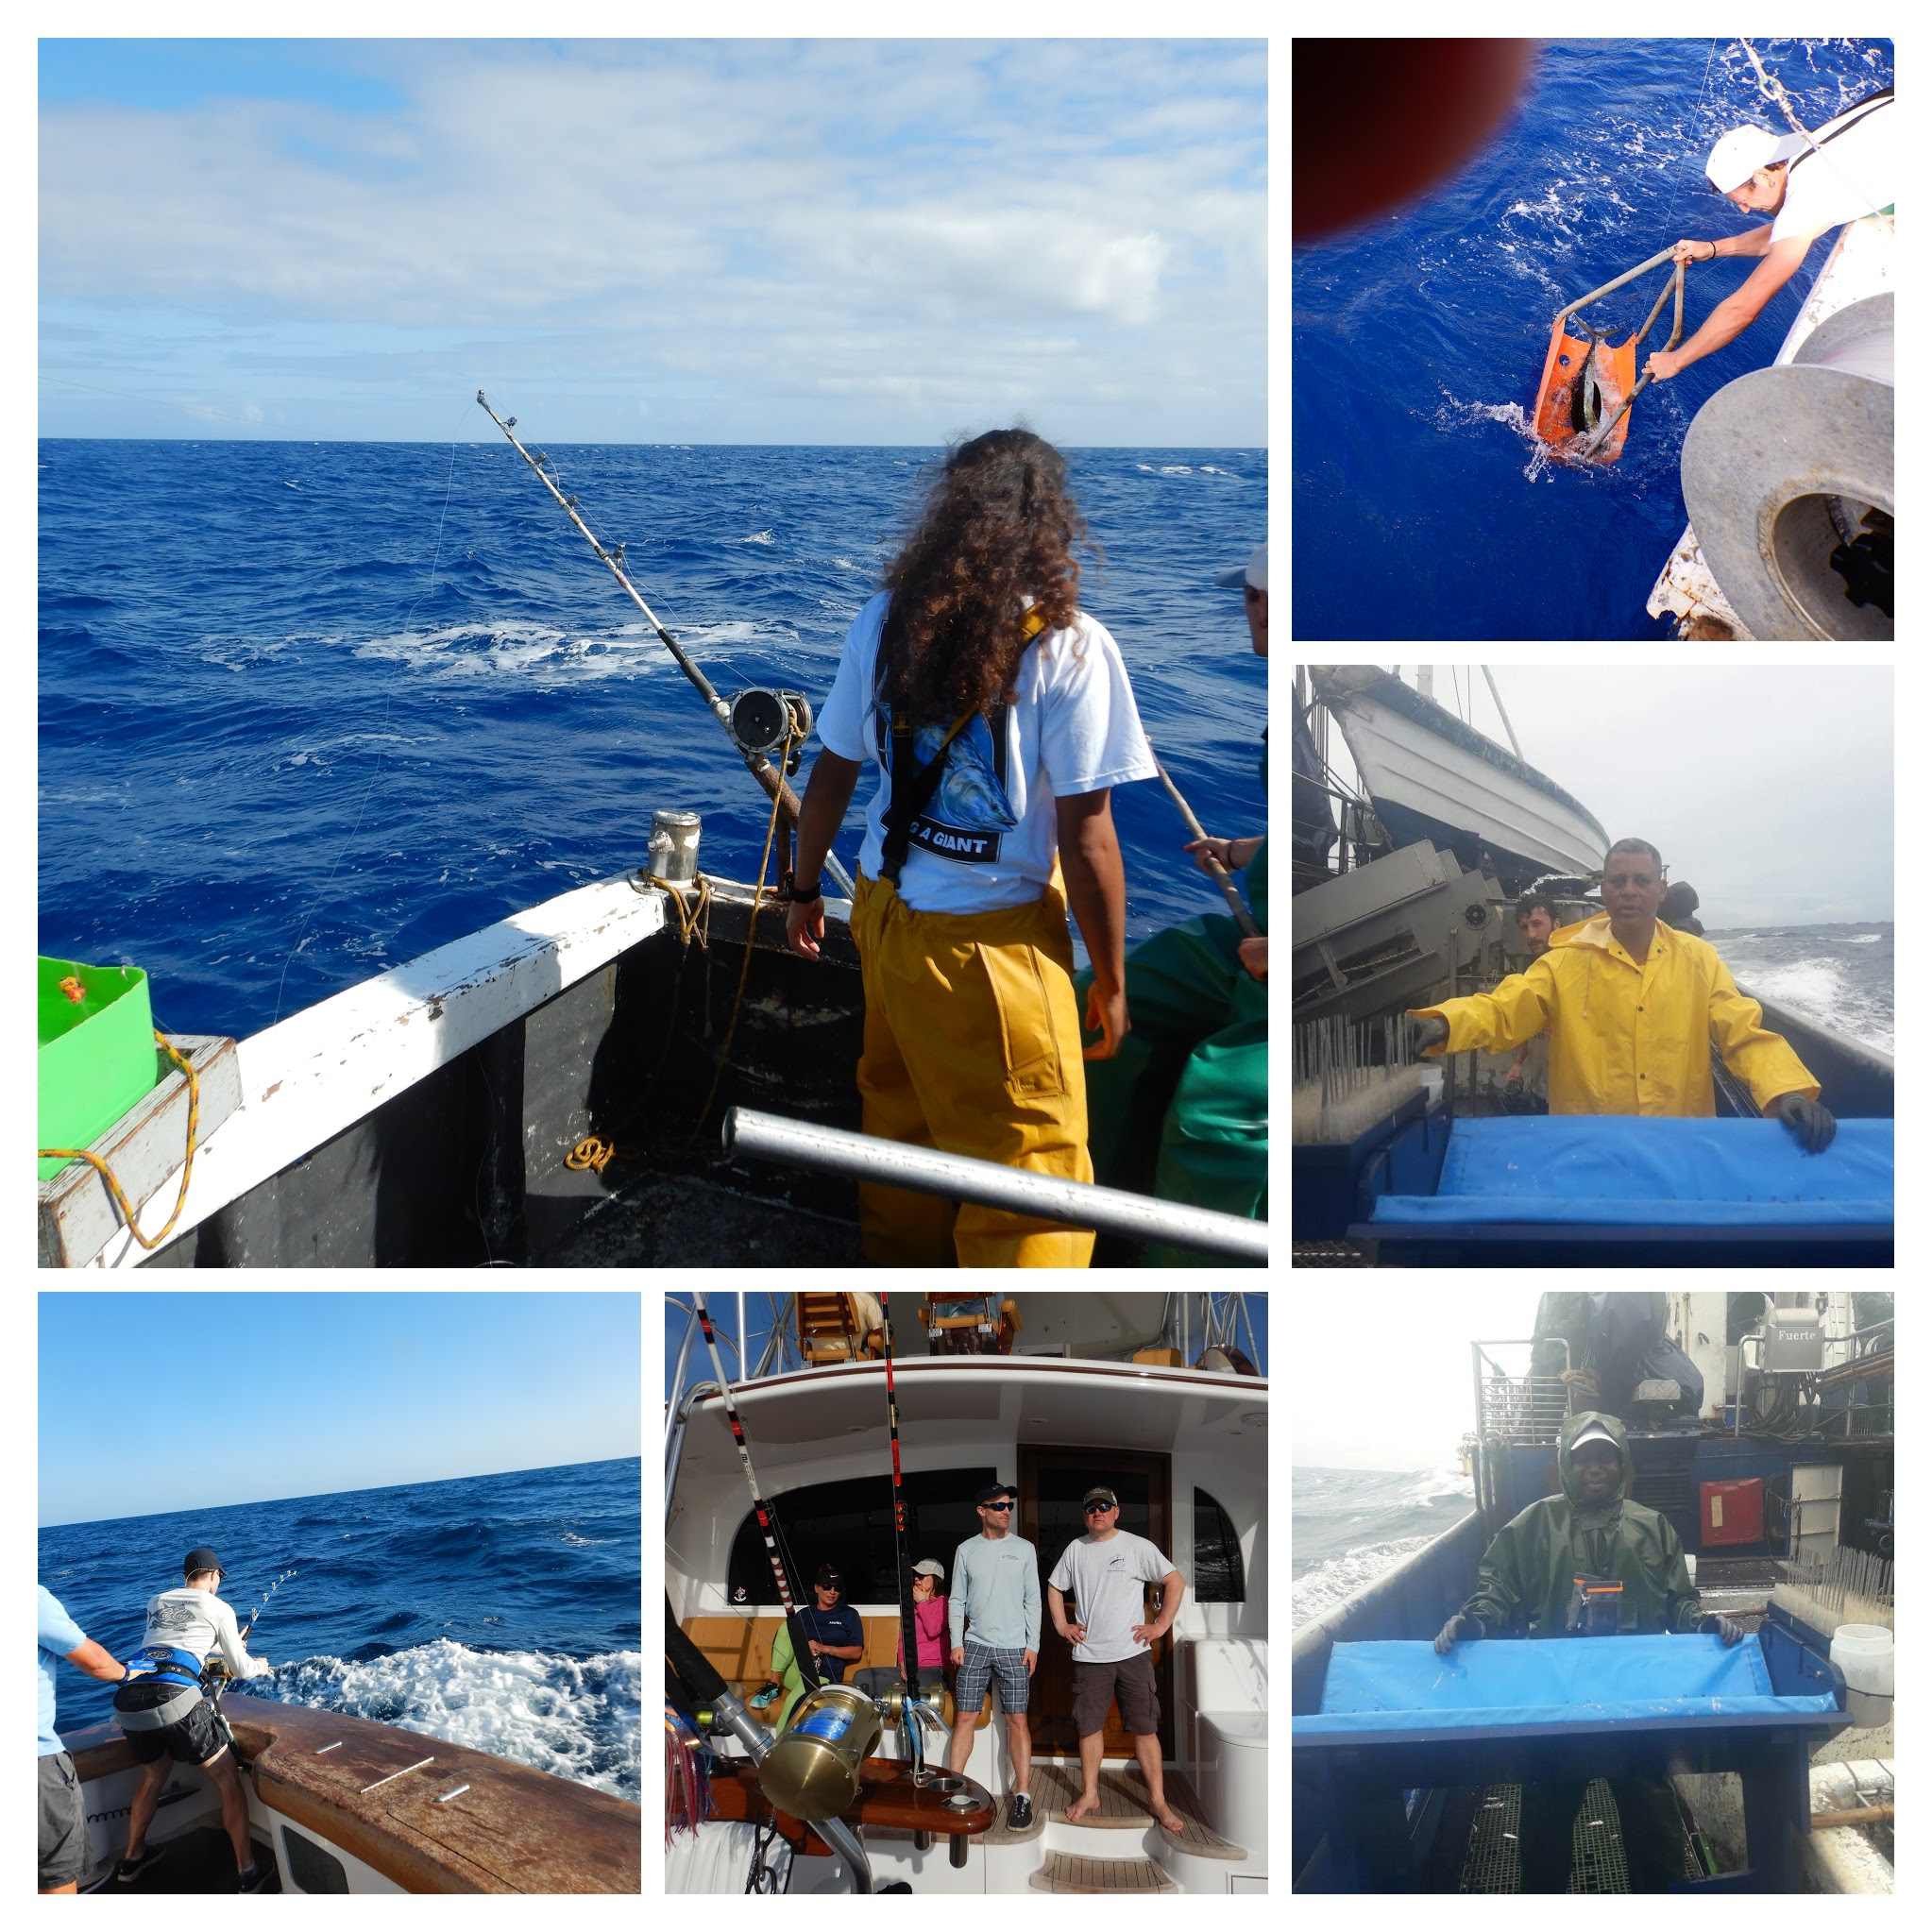
Research Programs - AOTTP
AOTTP Tagging Activity 2019

Slide 6

AOTTP – summary
Research Programs - AOTTP
Contracts
43 contracts awarded
Tagging at sea
114K tropical tuna tagged in >30 EEZs
>350 tagging cruises on >25 boats (commercial, RV, sport)
Tag Recovery
15K tags recovered, rewards paid
Visibility and tag awareness raising in 13 locations
Training
>40 scientists/technicians from developing countries trained in tagging at sea
>40 scientists/technicians trained in tag recovery
>30 scientists trained at data analysis workshops
Tag-seeding experiments under way
Database up and running
Smartphone applications for data collection up and running
Data analyses ongoing
Final Symposium

Slide 7
Research Programs - AOTTP
AOTTP – release and recovery (spaghetti)
Species | Releases | Recoveries | Recovery rate (%)
Bigeye | 21988 | 4514 | 20.5
Little tunny | 7770 | 569 | 7.3
Skipjack | 46259 | 3291 | 7.1
Wahoo | 277 | 3 | 1.1
Yellowfin | 37376 | 7300 | 19.5
Totals | 113670 | 15677 | 13.8

Slide 8
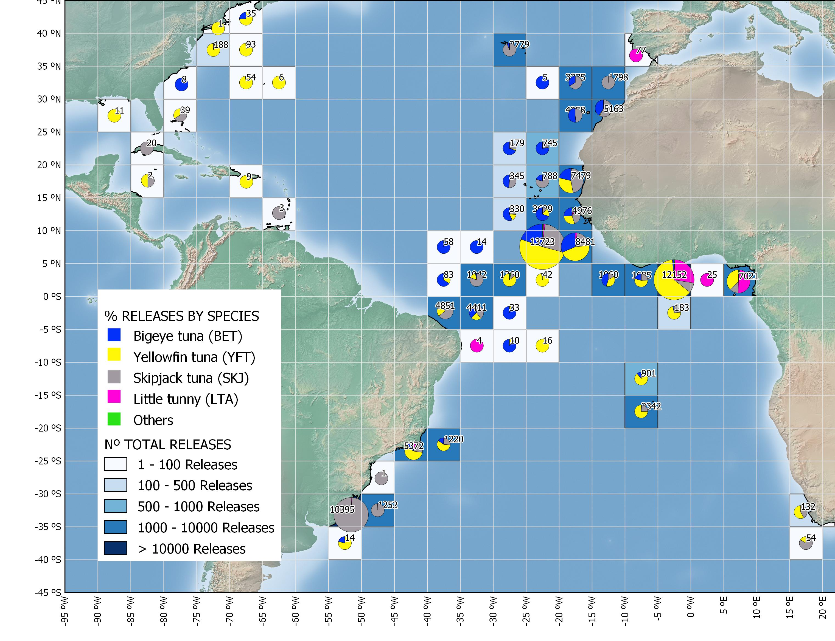
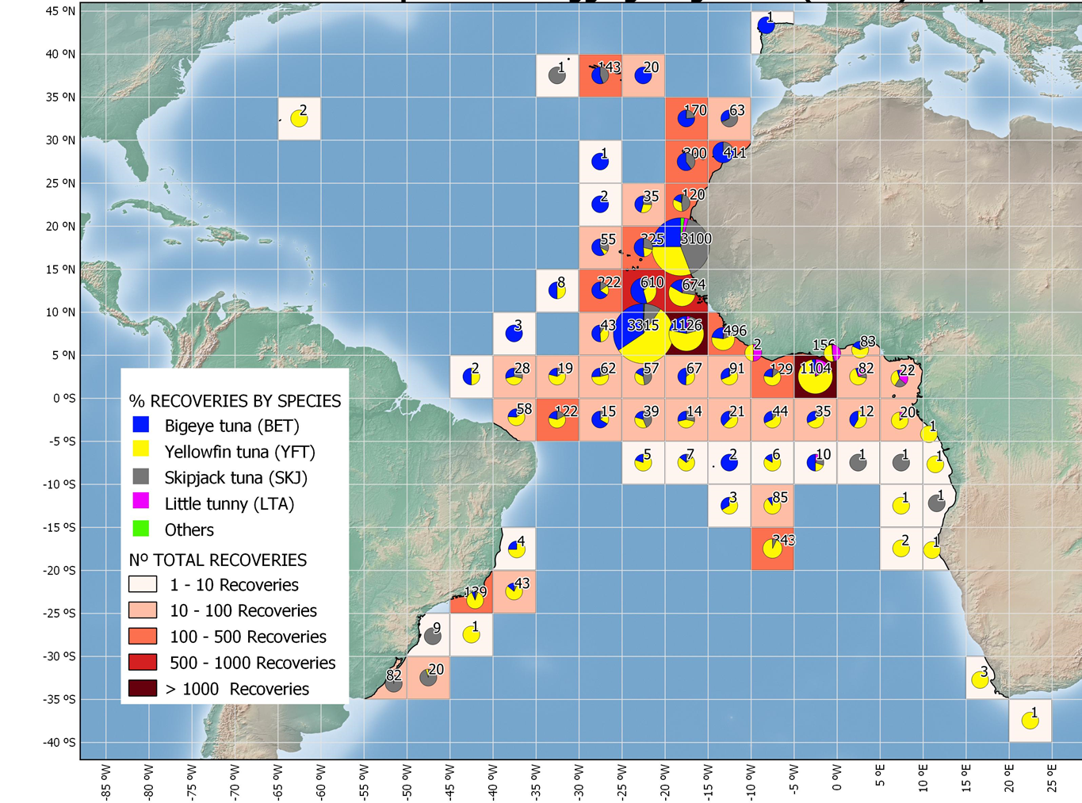
Tag Releases
Tag Recoveries

Slide 9
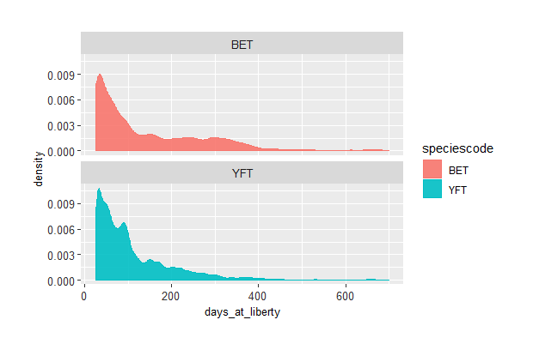
Research Programs - AOTTP
Days at Liberty
Species | Mean | Max
Bigeye | 118d (107) | 995d
Little tunny | 51d (66) | 709d
Skipjack | 61d (62) | 898d
Yellowfin | 91d (96) | 839d

Slide 10
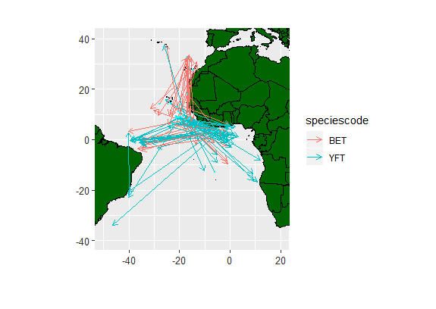
Research Programs - AOTTP
Tuna Movements
Species | Mean | Max
Bigeye | 226 NM | 2212 NM
Little tunny | 100 NM | 929NM
Skipjack | 203 NM | 2803 NM
Yellowfin | 164 NM | 3247 NM

Slide 11
Research Programs - AOTTP
All AOTTP electronic tag deployment
 | BET | SKJ | YFT
DS | 22 | 0 | 7
LOTEK ARCGEO9 | 27 | 0 | 2
LOTEK LAT2810 | 121 | 9 | 229
Microwave | 9 | 0 | 6
WC | 30 | 0 | 71
Total | 209 | 9 | 315
AOTTP archival tag recovery rates
 | released | recovered | %
BET | 148 | 20 | 13.5
SKJ | 9 | 0 | 0
YFT | 231 | 21 | 9.1

Slide 12
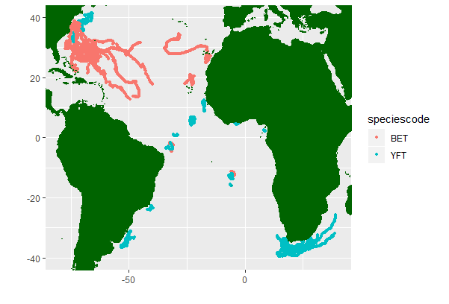
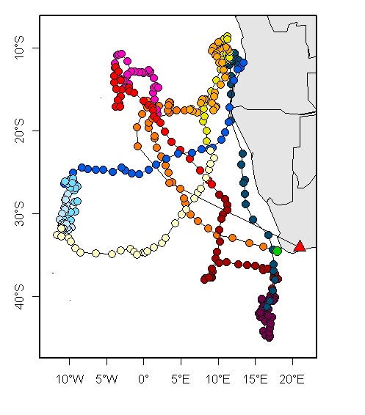
Research Programs - AOTTP
Internal archival nearly 1 year on YFT tagged off South Africa
Electronic tag tracks (Wildlife Computers)

Slide 13
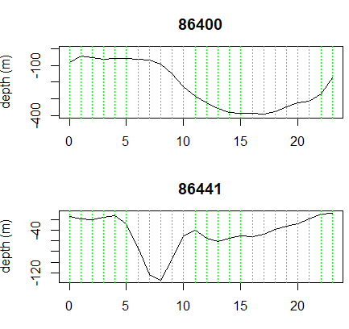
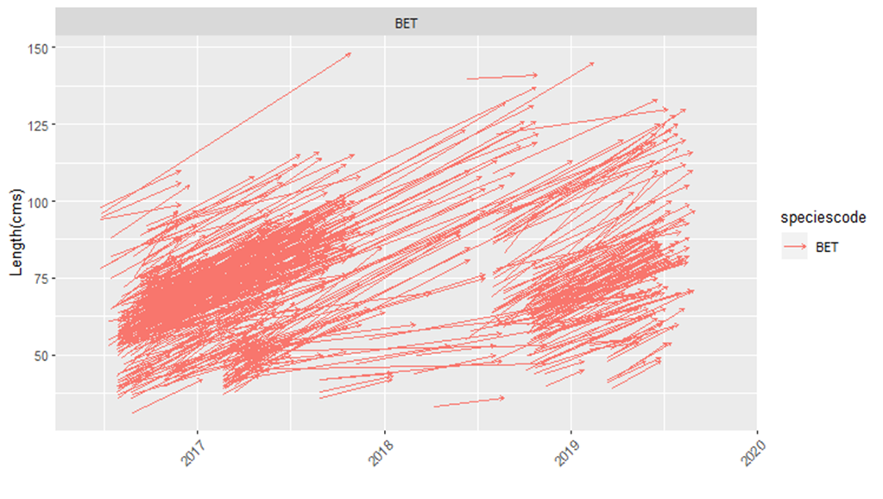
BET and YFT Diurnal Vertical Migration
Bigeye fork-length change (recovered baitboat >= 60 days at liberty)
BET
YFT

Slide 14

Research Programs - AOTTP
Tagging and Recovery
AOTTP – Capacity Building
Activities
Training in tagging at sea
Training in shore-based tag-recovery
Three data-analysis workshops last year
Two hardpart reading workshops this year
Integrate data-analytic activities
Awareness raising activities

Slide 15
AOTTP – Future - Programme ends Nov 2020
Research Programs - AOTTP
Tagging:
USA & Caribbean
St Helena
Northern Brazil
Research:
Targeted research projects ongoing
Final AOTTP Symposium will be held Dakar, Senegal - June 2020.
Special volume (Fisheries Research)-Guest Editors needed.
Data quality and checking will continue
‘Raw’ log-book data
VMS data
Final Evaluation
Exit Strategy
(TROs cease in Jan 2020)

Slide 16
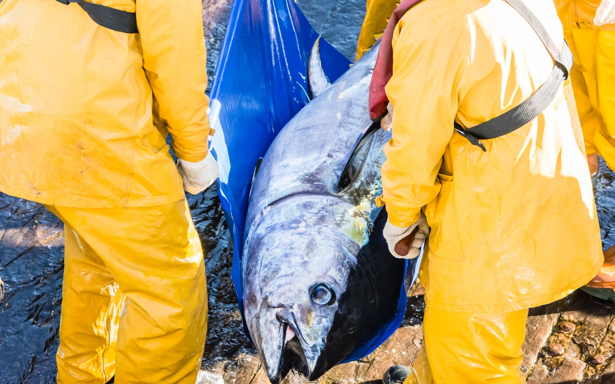



The Atlantic Ocean tropical Tuna Tagging Programme Final Symposium
Experience, Results and Lessons Learnt from Oceanic Tuna Tagging Campaigns: the AOTTP in Context.
Save the date!
16th to 18th June 2020, Dakar, Senegal
Experimental Design and Tagging Techniques
Age and Growth
Electronic Tagging
Mortality and Abundance
Impact of FADs
Stock Assessment and Management
Please register your interest by sending an email to aottp.symposium@iccat.int
Interested in sponsoring an Early Career Researcher? Contact us for more information!

Slide 17
Stock Status - Bigeye Tuna (BET)
No assessment, last assessment 2018
Update of fishery indicators:
  Catch
  Juvenile index of abundance based on acoustic buoys from FOBs/FADs
Biological work on ageing and migration from AOTPP

Slide 18
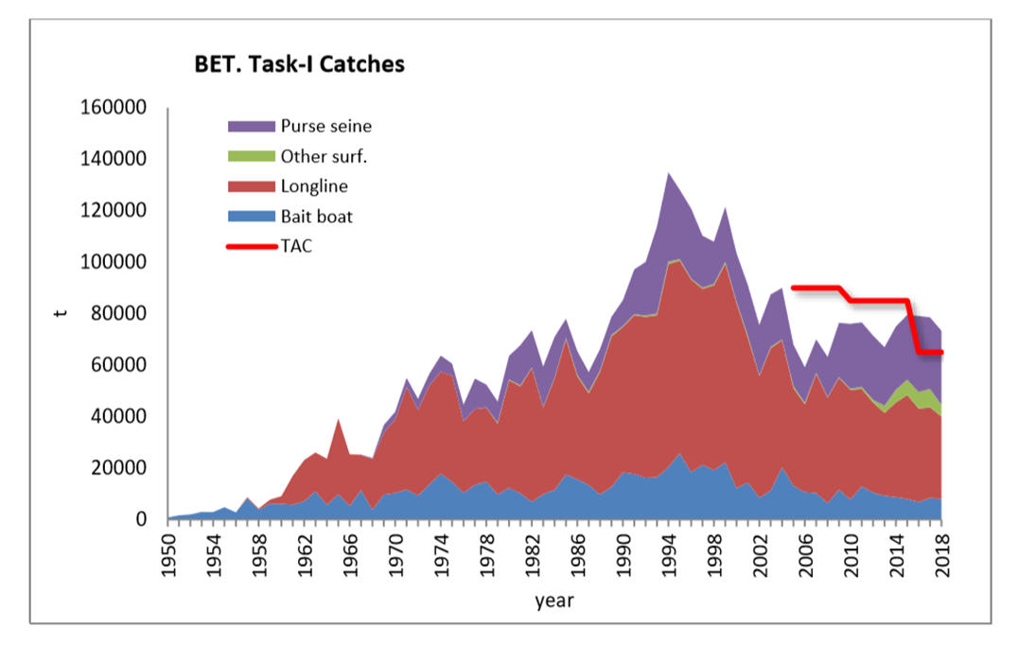
Stock Status - Bigeye Tuna (BET)
Nominal catches in the last three years have exceeded the agreed TAC (65,000 t) by 13-21% around.
2016/18 TAC 65,000t
2017 Catch 78,482 t
2018 Catch 73,366 t
Extensive review and re-estimation of annual catches. Large difference between preliminary catch of 2016 (72,375 t) reported in SCRS 2017 compared to the 2016 catch level used in the 2018 stock assessment (79,958 t).

Slide 19
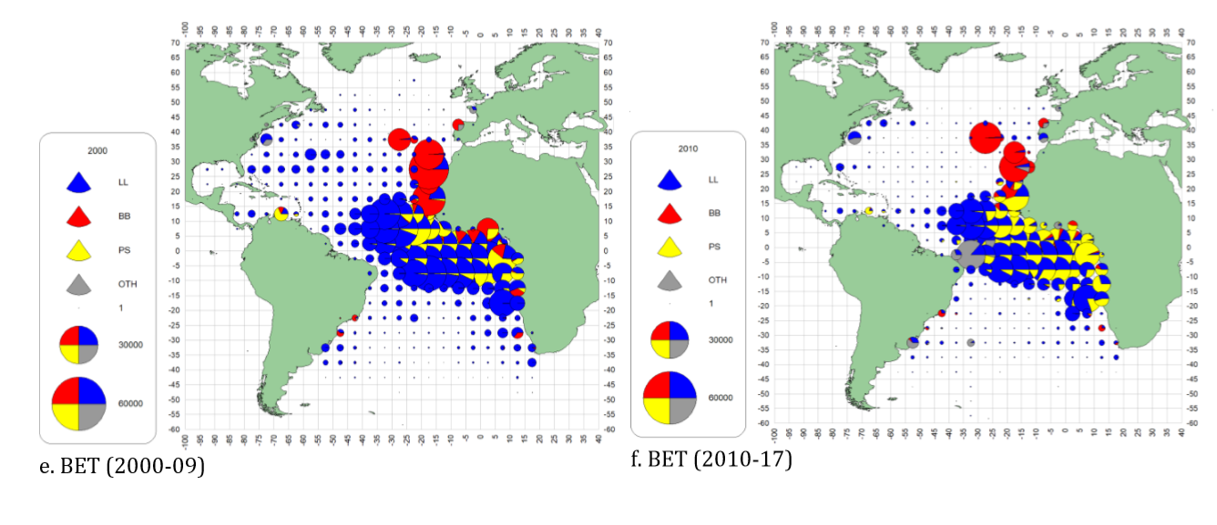
Stock Status - Bigeye Tuna (BET)
Geographical distribution of the bigeye tuna catch by major gears 2000-09 and 2010-2017.

Slide 20
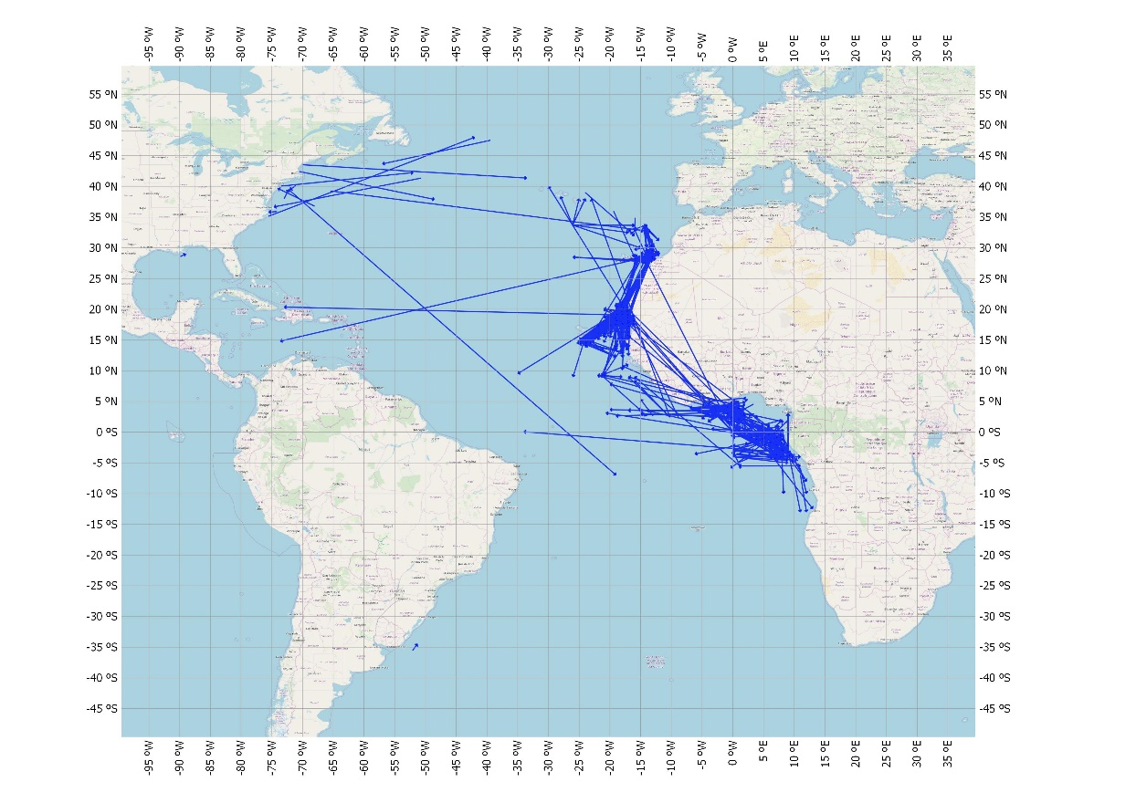
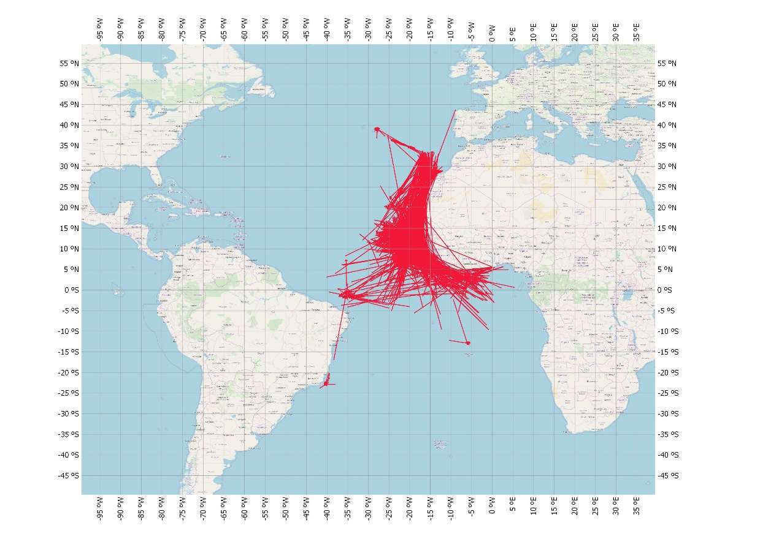
Stock Status - Bigeye Tuna (BET)
ICCAT Historical Tagging Data
AOTTP Tagging Data

Slide 21
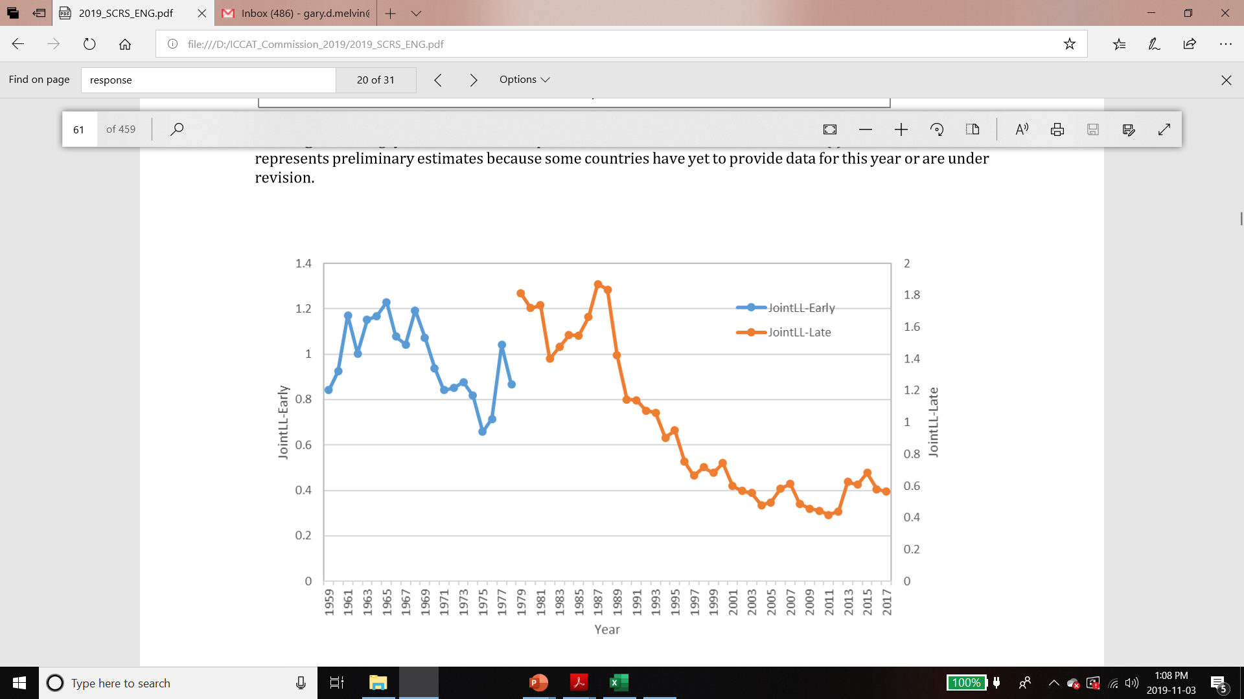
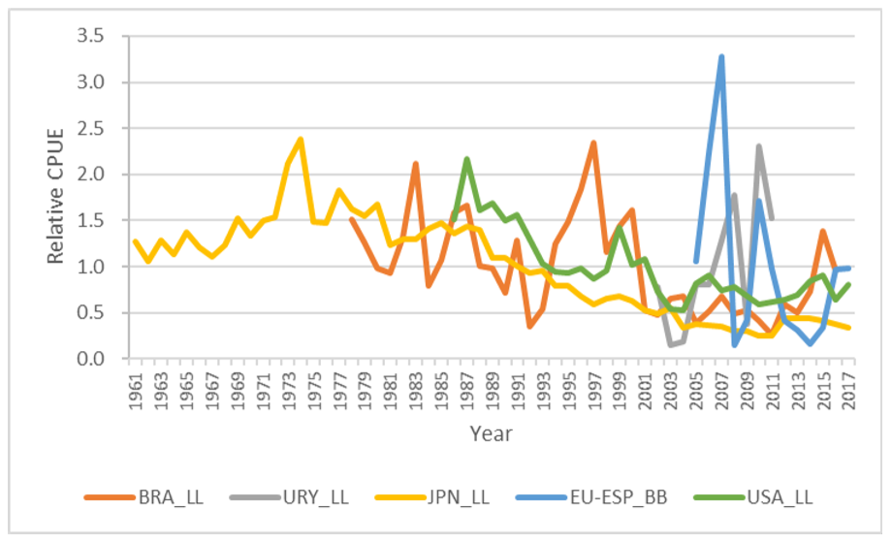
BET Fishery indicators
Annual relative indices of abundances for bigeye tuna from different fleets previously used in the stock assessment
Joint Longline index (1959-1978 without vessel identification and 1979-2017 with vessel identification included in the standardization.

Slide 22
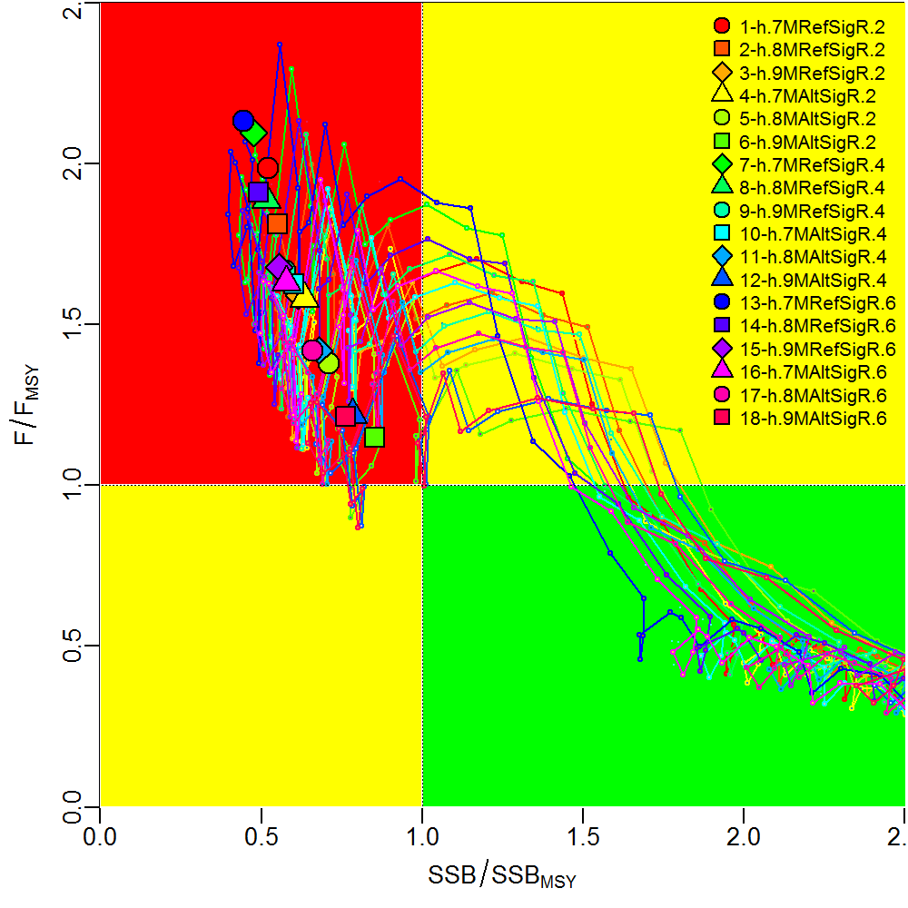
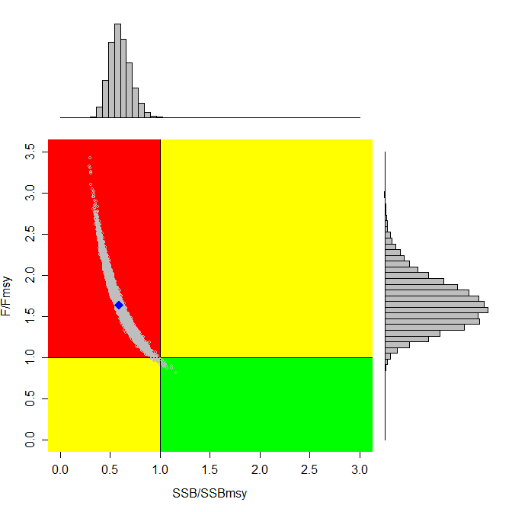
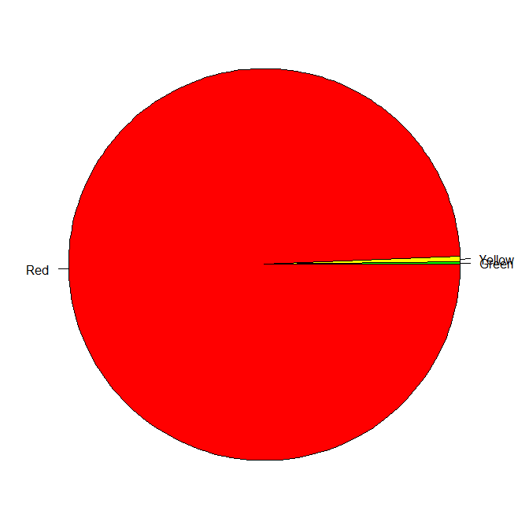
BET Stock Status
Blue square is the median estimate of stock status in 2017
Uncertainty in the stock assessment results has decreased from previous stock assessments, likely due to the use of the improved joint LL index, the confirmation that catches continue to exceed TACs, and the use of a single model platform (integrated analysis SS).

Slide 23
BET Fishery indicators
ATLANTIC BIGEYE TUNA SUMMARY
Maximum Sustainable Yield 76,232 t (72,664-79,700 t)¹
Current (2018) Yield 72,647 t²
Relative Spawning Biomass (SSB₂₀₁₇/SSB_{MSY}) 0.59 (0.42-0.80)¹
Relative Fishing Mortality (F₂₀₁₇/F_{MSY}) 1.63 (1.14-2.12)¹
Stock Status (2017) Overfished: Yes
Overfishing: Yes
Important:
The current MSY may be below what was achieved in past decades because overall selectivity has shifted to smaller fish. Calculations of the time-varying benchmarks from SS3 uncertainty grid show a long-term increase in SSBMSY and a general long- term decrease in MSY

Slide 24
BET Fishery indicators
Probability of Not Overfished (SSB >= SSBmsy) and Overfishing not occurring (F <= F_{MSY})
TAC
2018
Catches

Slide 25

YFT Stock Assessment
Stock Assessment 2019 – Input data up to 1950-2018
Revised Task I and Task II catch/effort and size data for 1973-2013 and updated for 2012/2018.
Ages up to 18 years were observed in otoliths and validated using 14C bomb radiocarbon.
Growth of YFT better estimated using a Richards function than a von Bertalanffy function (AOTTP information)
Age-specific natural mortality function (e.g. Lorenzen) based on T max of 18 rather than 11 used in previous assessment.
Several New Indices used in the 2019 assessment
Yellowfin Tuna

Slide 26
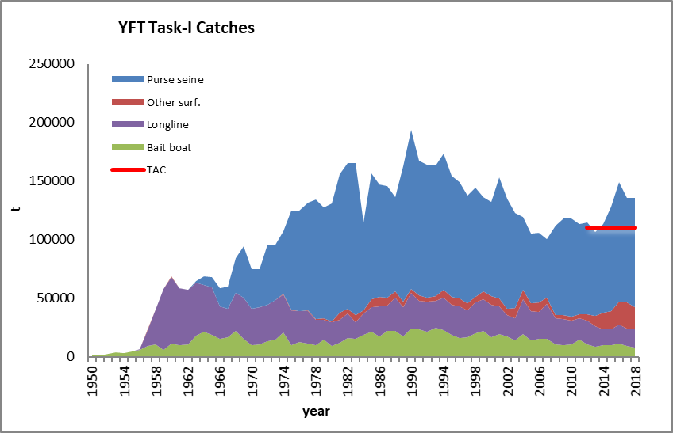
YFT Fishery Indicators
3 Major Gears (PS, BB, LL)
Highest landings (194,000 t) in 1990.
Decreased to 100,000 t by 2007.
A TAC of 110,000 t was adopted in 2012,
Since 2015 landings have averaged 137,000 t.
Purse seine vessels targeting tropical tunas in the eastern Atlantic has increased in the last five years by 18%, (49 to 58).

Slide 27
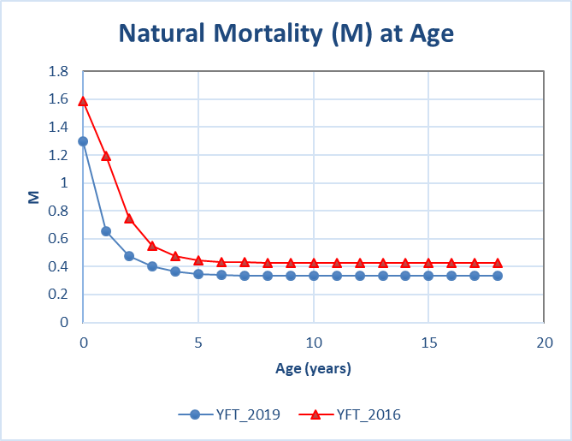
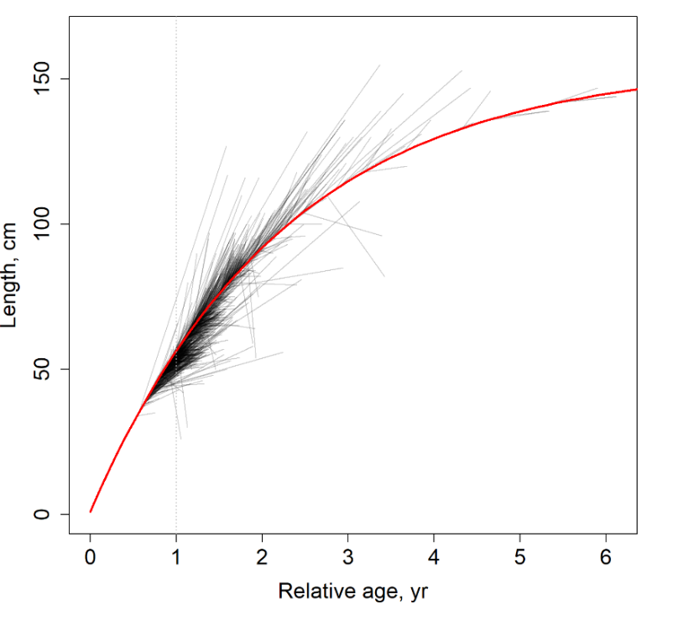
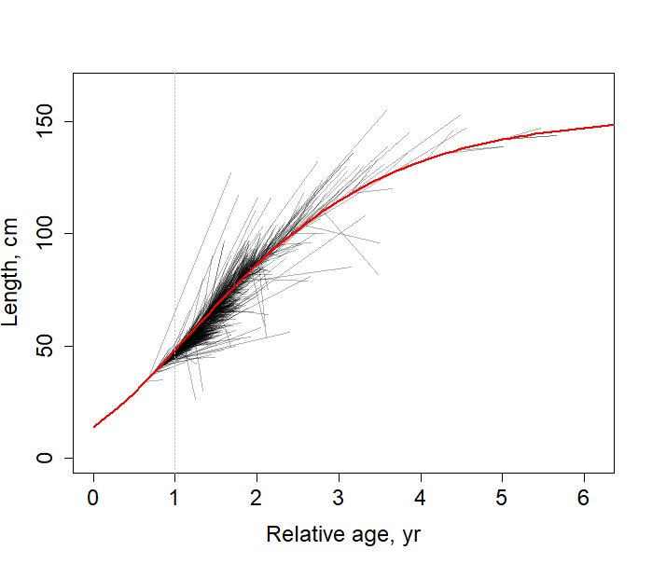
BET Fishery indicators
Growth increments from AOTTP fish measured upon recovery indicate that yellowfin growth is best estimated using a Richard’s function
von Bertalannfy
Richards
The implied 2019 natural mortality based on the Tmax of 18 based on AOTTP information

Slide 28
YFT Fishery indicators
A joint LL index was constructed for the fleets of USA, Korea, Chinese-Taipei, Brazil and Japan.
New indices for the surface fleets were also used, including an “echosounder buoy derived” index of juveniles associated with FADs.

Slide 29
YFT Stock Assessment
Stock Assessment Models:
2 Production Models (JABBA and MBP):
  JABBA – 4 model runs
  MBP – 1 model run
1 Age Structured Model: Stock Synthesis:
  4 model runs
The trend in the estimated biomass (relative to BMSY) for all models shows a general continuous decline through time.
Combined results with Equal weighting to surplus production model and integrated assessment model used to develop management advice.

Slide 30
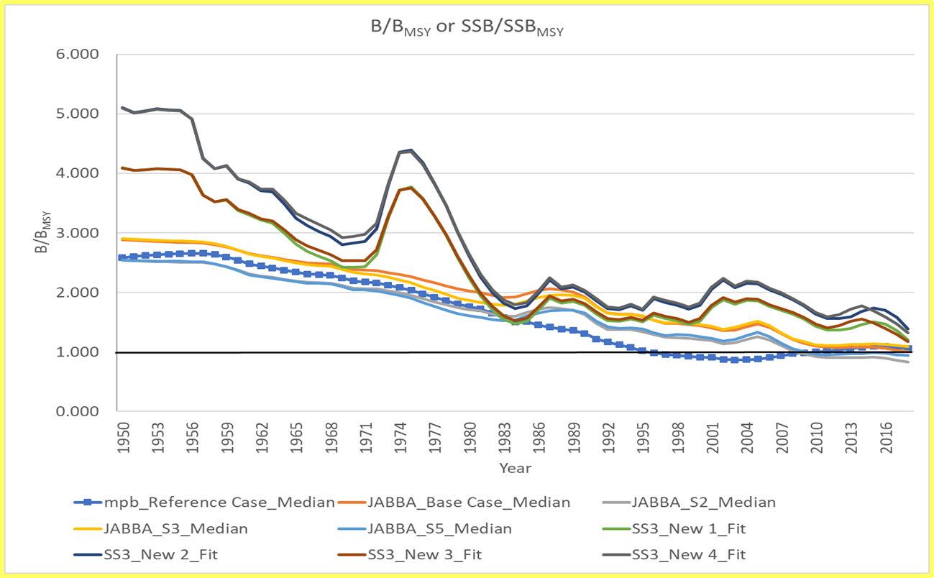
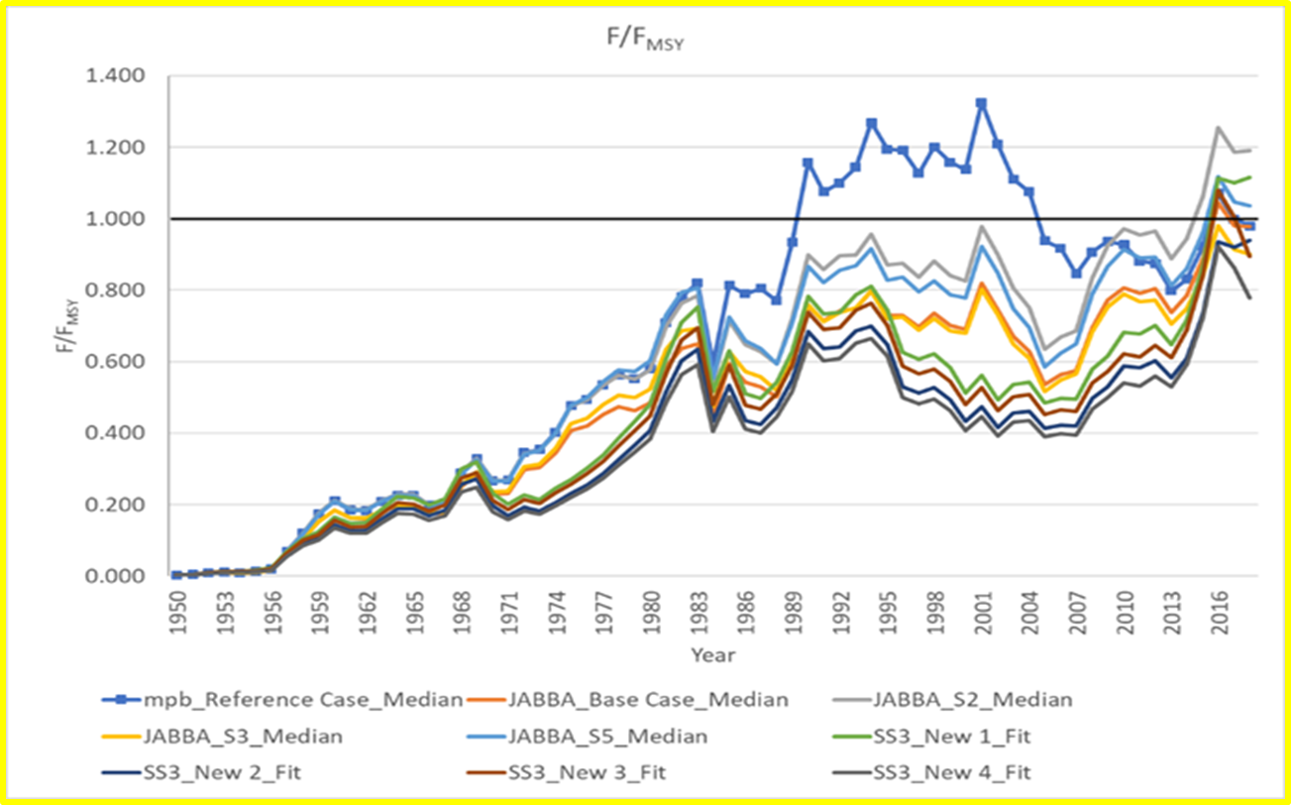
YFT Stock Assessment
Assessment Results
Biomass relative to Bmsy
Fishing Mortality relative to Fmsy

Slide 31
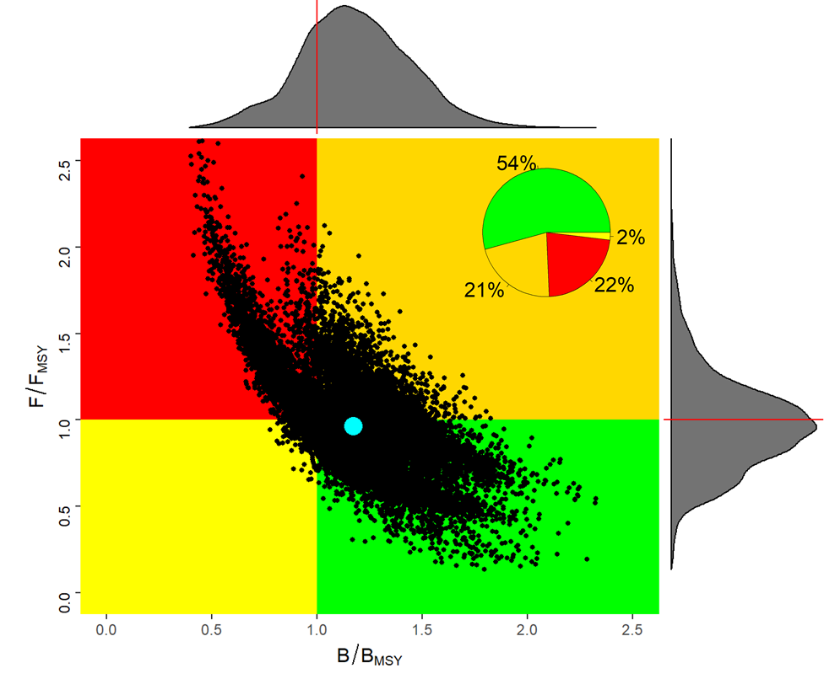
YFT Stock Status
Stock Assessment Results:
Combined Results of Stock Synthesis, JABBA and MPB
B/B_{MSY} = 1.17
  Not Overfished
F/F_{MSY} = 0.96
  Not Overfishing
MSY = 121,298 t
  Mean MSY 2016-2018
The 2019 result appears more optimistic than in 2016. However, the group cautioned that the difference in the results is not due to stock recovery. Instead, the perceived improvement is more likely due to changes in key data inputs (M, growth, indices) and the suite of models applied (JABBA, MPB, SS).

Slide 32
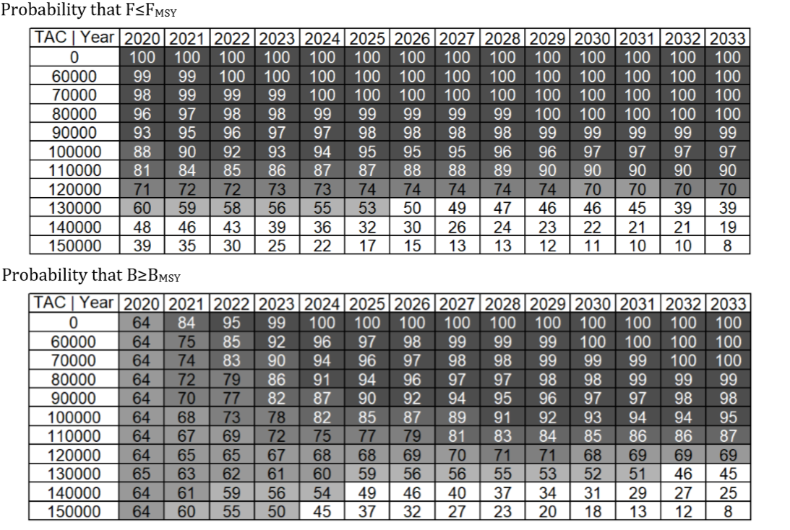
YFT Outlook
Maintaining a TAC of 120,000 t is expected to maintain F≤F_{MSY} through 2033 with at least 70% probability
Maintaining a TAC of 120,000 t is expected to maintain B≥B_{MSY} through 2033 with at least 64% probability

Slide 33
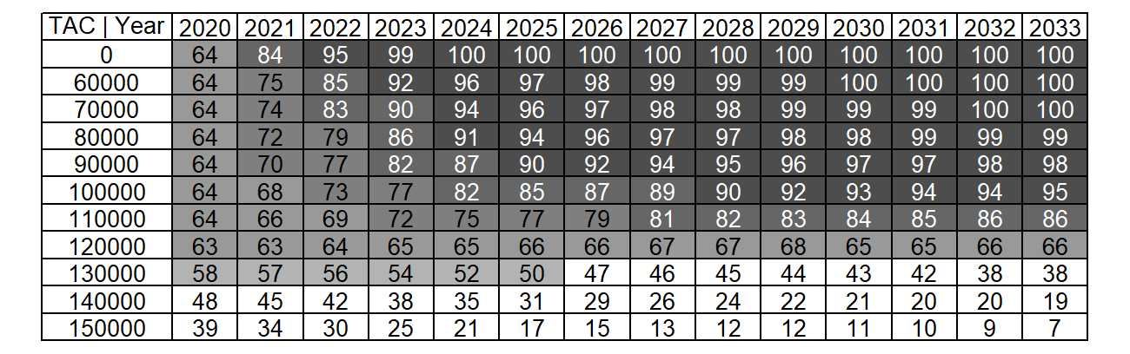
YFT Stock Outlook
Maintaining a TAC of 120,000 t is expected to maintain healthy stock status (no overfishing, not overfished) through 2033 with at least 63% probability
Joint Probability that F≤F_{MSY} and B≥B_{MSY}

Slide 34
YFT Stock Assessment
Management Recommendations
Catches above 120,000 t are expected to further degrade the condition of the yellowfin stock. Since 2016, catch has averaged 137,000 t. Catches above 140,000 t carry an increased risk of driving the stock below 20%B_{MSY} (13% by 2033).
Significant overages are frequent. Existing conservation and management measures appear to be insufficient. The Group recommends that the Commission strengthen such measures.
Increased harvests on small yellowfin and bigeye tunas has negative consequences to both long-term sustainable yield and stock status.
Should the Commission wish to increase long-term sustainable yield, the Group recommends that effective measures be found to reduce fishing mortality on small yellowfin and bigeye tuna (e.g. FOB-related and other fishing mortality of small yellowfin tuna).

Slide 35
Stock Status Skipjack (SKJ)
Two stocks –Eastern Atlantic and western Atlantic.
Last Stock assessment for east and west Skipjack was in 2014.
Next stock assessment scheduled for 2020.
There are currently no specific regulations in place for skipjack tuna.
Committee was not in a position to provide a reliable estimate of the maximum sustainable yield for the eastern stock.
Catches updated to 2018
Indices not updated since the last assessment.
Essentially no changes in advice.

Slide 36
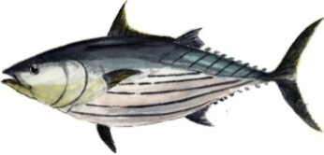
Fisheries indicators
Catches – Tasks I and II
305,300t
Decline in catch since the early 1990s (due to a decrease in nominal fishing effort and/or to a moratorium effect), followed by a new strong increase in the recent years.
Catchability of SKJ increased in the early 1990s due to FADs fishing
282,427 t
22,873 t
16/11/2019
36
SKJ EXECUTIVE SUMMARY
Notes:
36

Slide 37
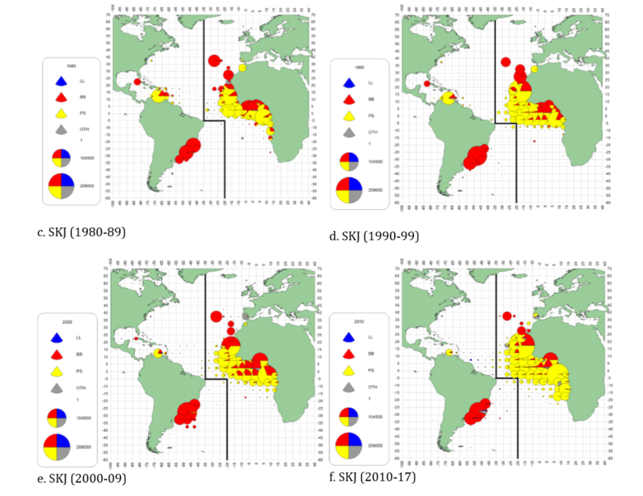
Skipjack tuna Distribution
Geographical distribution of the skipjack catch by major gears and decade to 2017.

Slide 38
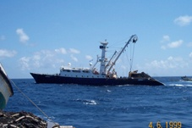
Fisheries indicators
Spatial distribution of SKJ for the PS fisheries
Purse seiner
(2000-2018)
16/11/2019
38
SKJ EXECUTIVE SUMMARY
Notes:
38

Slide 39
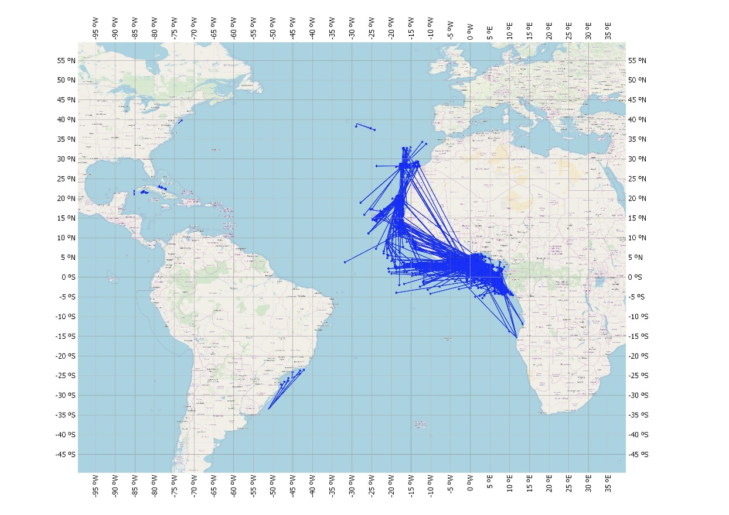
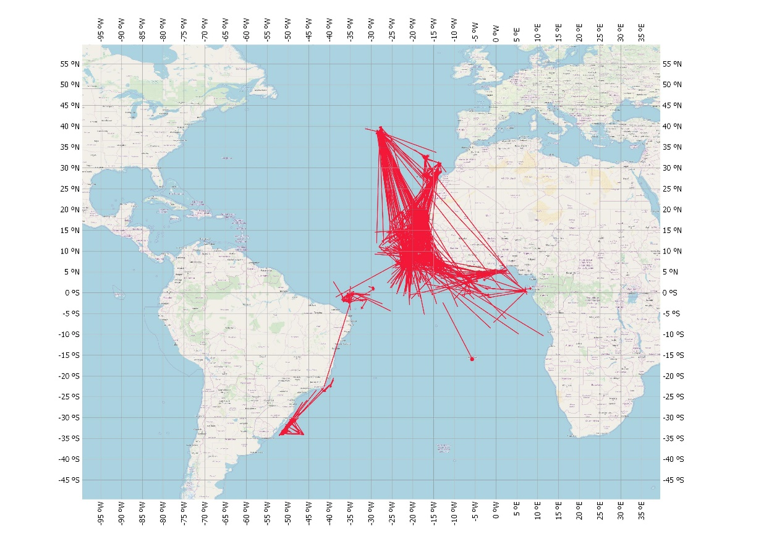
Fisheries indicators
Apparent movements of SKJ calculated from the historical and current ICCAT conventional tagging data.
Historical ICCAT data
AOTTP data
16/11/2019
39
SKJ EXECUTIVE SUMMARY
Notes:
39

Slide 40
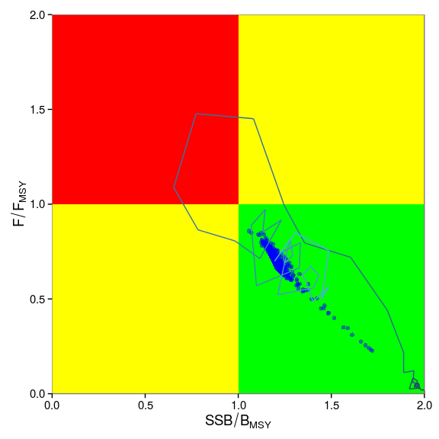
STATE OF THE STOCKS
State of the stocks
Western Skipjack
 | East Atlantic | West Atlantic
Maximum Sustainable Yield (MSY) | Probably higher than previous estimates (143,000-170,000) | Around 30,000-32,000 t
Current yield (2016) | 282,427 t | 22,873 t
Current Replacement Yield | Unknown | Somewhat below 32,000 t
Relative Biomass (B₂₀₁₃/B_{MSY}) | Likely >1 | Probably close to 1.3
Mortality due to fishing (F₂₀₁₃/F_{MSY}) | Likely <1 | Probably close to 0.7
Management measures in force | Rec. 16-01 | None
16/11/2019
40
SKJ EXECUTIVE SUMMARY
Notes:
40

Slide 41
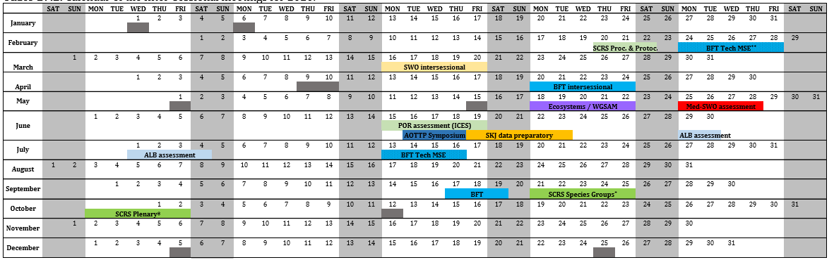
Inter-sessional SCRS meetings
SCRS Calendar for 2020
2020 – Data preparatory
2021 - SKJ Assessment

Slide 42
Management Recommendations
Bigeye Tuna
The Commission should urgently ensure that catches are appropriately reduced to end overfishing and to allow the stock to recover following the decision framework adopted in paragraph 3 of Rec. 11-13. Furthermore, the Committee notes that the necessary reduction of fishing mortality could be not achieved with current and previous FAD time area closures and/or changes to fleet allocation alone.
The Commission should be aware that increased harvests on small fishes by FADs and other fisheries as well as the development of new fisheries could have had negative consequences for the productivity of bigeye tuna fisheries (e.g. reduced yield at MSY and increased SSB required to produce MSY) (BET-Figure 9) and, therefore, should the Commission wish to increase long-term sustainable yield, the Committee continues to recommend that effective measures be found to reduce fishing mortality of small bigeye tunas.

Slide 43
Management Recommendations
Yellowfin Tuna
Catches above 120,000 t are expected to further degrade the condition of the yellowfin stock. Since 2016, catch has averaged 137,000 t. Catches above 140,000 t carry an increased risk of driving the stock below 20%B_{MSY} (13% by 2033).
Significant overages are frequent. Existing conservation and management measures appear to be insufficient. The Group recommends that the Commission strengthen such measures.
Increased harvests on small yellowfin and bigeye tunas has negative consequences to both long-term sustainable yield and stock status.
Should the Commission wish to increase long-term sustainable yield, the Group recommends that effective measures be found to reduce fishing mortality on small yellowfin and bigeye tuna (e.g. FOB-related and other fishing mortality of small yellowfin tuna).

Slide 44
Management Recommendations
Skipjack Tuna
Committee recommends that the catch and effort levels for the eastern stock do not exceed the 2012-2013 catch or effort. Catches in 2016-2018 exceeded those levels by 6%, 11% and 28%, respectively.
The Commission should be aware that increasing harvests and fishing effort for skipjack could lead to involuntary consequences for other species caught in combination with skipjack in certain fisheries (juveniles of yellowfin and bigeye).
For the West Atlantic, the Committee recommends that the catches should not be allowed to exceed the MSY.

Slide 45
Recommendations with financial implications
Tropical Tuna
Support the continuation of the AOTTP activities in 2020
Continuation of recovery efforts, tag seeding, and ageing of collected samples. Requires funding of Euros 50,000. Continuation of such activities are especially important to support the upcoming skipjack assessment.
Support the continuation of MSE for tropical tunas:
Maintain the momentum and capitalize on recent assessment of bigeye tuna in 2018, yellowfin tuna in 2019 and the proposed skipjack assessment in 2021. Completed phase II in 2020 and phase III in 2021. Requires 125,000 Euro funding from the Commission in each 2020 and 2021.

Slide 46
Response to the Commission
19.10 Evaluate the efficacy of the area/time closure referred to in paragraph 13 for the reduction of catches of tropical tuna juveniles. [Rec. 16-01], paragraph 15
The Group has provided prior responses to the Commission. Some preliminary analyses conducted with AOTTP data have provided new insights on the movements of tuna in the Gulf of Guinea. Tagged tuna showed evidence of incomplete mixing throughout the distribution of the stock for at least a year post-release. This implies that tuna can remain in the same area where they are released for a few quarters, including the closure area. Analyses have also noted differences in the migration and residence time of large and small tunas. The Group has incorporated in their 2020 workplan activities that will help provide additional information to the Commission. The Group is using AOTTP data to review the prior analysis conducted in the effectiveness of the current area/time closure as part of a broader review of effectiveness of control measures (see tropical tuna workplan).

Slide 47
Response to the Commission
19.11 Provide performance indicators for skipjack, bigeye and yellowfin tuna, with the perspective to develop management strategy evaluations for tropical tunas. [Rec. 16-01], paragraph 49(b)
In the first phase of the project, the Group determined that the performance indicators used for albacore were considered adequate in the interim for tropical tunas (Completed in 2018).
No funding was provided to complete phases two and three in 2019. It is important to maintain the momentum of progress on MSE for tropical tunas and to capitalize on recent assessment of bigeye tuna in 2018, yellowfin tuna in 2019 and the proposed skipjack assessment in 2020. Information and knowledge gained on these assessments is essential to support the MSE process.
In order to continue and develop the MSE work for tropical tunas, costs, timelines, and workplan are outlined below.

Slide 48
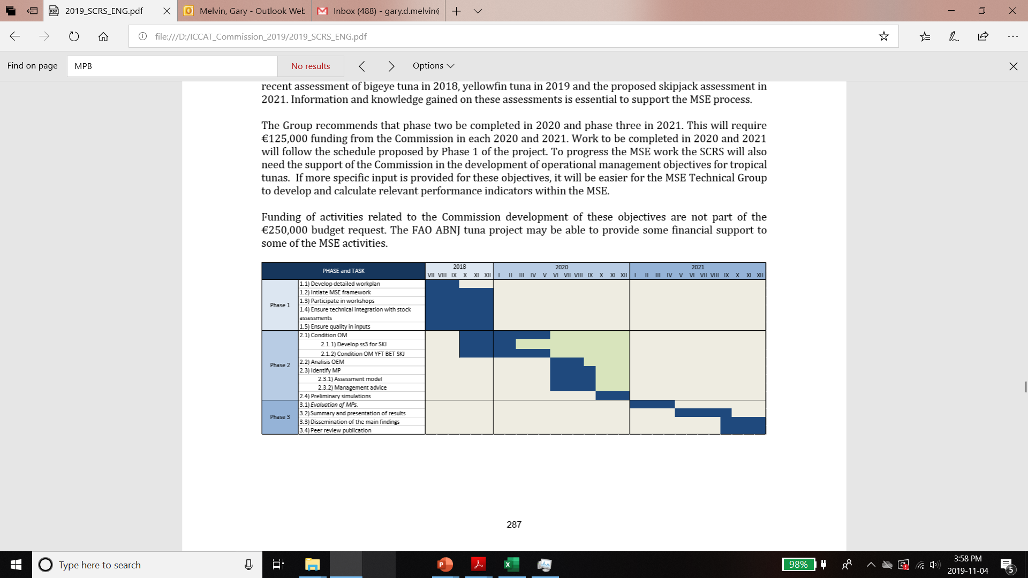
Response to the Commission
19.11 Provide performance indicators for skipjack, bigeye and yellowfin tuna. Continued.
The Group recommends that phase two be completed in 2020 and phase three in 2021. This will require €125,000 funding from the Commission in each 2020 and 2021.
The SCRS will also need the support of the Commission in the development of operational management objectives for tropical tunas.
Activities related to the Commission development of these objectives are not part of the €250,000 budget request.

Slide 49
Response to the Commission
19.12 The SCRS shall evaluate the contribution of by-catches and discards to the overall catches in ICCAT tropical tuna fisheries and advise the Commission on possible measures allowing to reduce discards and to mitigate onboard post-harvest losses and by-catch in ICCAT tropical tuna fisheries. [Rec. 16-01], paragraph 53
The SCRS provided a response in the 2017 SCRS report describing the average by-catch and discards from the EU tropical tuna purse seine fishery. The response was limited as it contained data only for the EU tropical tuna purse seine fishery and was derived from a scientific study.
In 2019 the ICCAT Secretariat described a review on National Observer Programs (form ST-09) and the ongoing efforts to store such information in a dedicated database. Several data cleaning and cross-checking tasks are pending before it can be used to estimate by-catch.
The Group intends to use the available ST-09 data for longline fleets targeting tropical tunas to estimate bycatch from these fleets in 2020. This will require collaboration between the tropical tuna Species Group, ICCAT Secretariat, Statistics Sub-committee and Ecosystem subcommittee

Slide 50
Response to the Commission
19.13 Review the available information on fishing capacity and provide advice on adapting the fishing capacity in all its components (number of FADs, number of fishing vessels and support vessels) to achieve the management objectives for tropical tuna species. Rec. 16-01, Annex 8
In the last few years, reported catches of YFT and BET have exceeded the current TACs established for these two stocks and catches of SKJ have exceeded the levels recommended by the SCRS
Annex 8 of Rec. 2016-01 requested that the SCRS include in its workplan a review of “…the available information on fishing capacity and provide advice on adapting the fishing capacity in all its components (number of FADs, number of fishing vessels and support vessels) to achieve the management objectives for tropical tuna species.”
The 2018 report of Panel 1 also mentioned that “The Commission has to find ways to make sure that catches do not exceed the TAC” and to reduce the mortality of juvenile BET and YFT through a range of possible measures

Slide 51
Response to the Commission
19.13 Review the available information on fishing capacity and provide advice on adapting the fishing capacity in all its components (number of FADs, number of fishing vessels and support vessels) to achieve the management objectives for tropical tuna species. Rec. 16-01, Annex 8
The SCRS reviewed a new analysis that evaluates the possible future benefits of using alternative management measures for tropical tunas based on moving from a system that involves primarily output based controls to another that relies on input-based controls for its purse seine fishery. Specifically, the analysis proposes that the SCRS would calculate a sustainable catch limit and how such limit should be divided among major gears. The SCRS notes that it would require guidance from the Commission to complete this task.

Slide 52
Tropical tuna Workplan -2020
Tropical Tunas Workplan for 2020/2021
Work will focus on six activities:
  A. Assessment of skipjacks stocks (detailed Workplan in Appendix 13)
  B. Management Strategy Evaluation (Appendix 13)
  C. Evaluation of effectiveness of management measures
  D. Estimation of bycatch contributions of the main gears harvesting tropical tunas
  E. Contribute to the AOTTP
  F. Contribute to the Joint tRFMO FAD Working Group

